Slide 1

A decentralized escrow protocol to transfer assets using blockchain
PROJECT REPORT
Submitted by
NITHISHHARIHARAN M- 1210121521057
Guided by
Ms. B . LAVANYA MCA
BACHELOR OF COMPUTER APPLICATION
IN
DEPARTMENT OF COMPUTER SCIENCE AND APPLICATIONS

Slide 2
INTRODUCTION
A decentralized escrow protocol makes it easy for people who don't trust each other to make safe payments. The Eskro protocol is used. Before a transaction can be made, tokens are sent to an escrow, which is a third-party smart contract. The escrow holds the tokens until the conditions for payment are met. Both the agreed-upon product or service and the agreed-upon payment must be made by all parties involved in the transaction. One party shouldn't be able to back out of a deal at the other party's expense. If the payment terms depend on outside information, like when a product is shipped, the oracle pattern can be used to give the escrow the information it needs. As soon as the smart contract code is put on the blockchain, it can't be changed. This makes sure that the escrow functionality is safe. This gives everyone involved in the trade the peace of mind that they won't be taken advantage of.

Slide 3
PROBLEM STATEMENT
A decentralized escrow protocol that facilitates secure P2P payments between trustless parties
There is an inherent risk of fraud in the majority of transactions, both online and offline, where a buyer and a seller exchange goods or services for money. What should be sent out first, the goods or the money is another constant debate.
These transactions could involve anything from purchasing products from peer-to-peer marketplaces like eBay to receiving payment from a customer for freelancing work. Each year, these transactions reach up to $100 trillion worldwide.

Slide 4
Exsisting System
In the existing system, the size of the proof stored in the blockchain for each transaction is extremely large. The existing system is not trustable and reliable. The existing system requires the use of third party and charges extra fees than necessary. The existing escrow protocols are neither transparent not secure, untrusted parties who wish to carry out a transaction face several challenges. Firstly, they may not trust each other, and there is a possibility that one party may fail to meet their obligation, leading to disputes and potential fraud. Secondly, they may have to rely on a third-party intermediary to hold the funds until the transaction is complete, which adds an extra layer of complexity and cost to the transaction.
Furthermore, the existing system has several limitations. For instance, it is not decentralized, meaning that it relies on a centralized entity to hold the funds and oversee the transaction. This centralization makes the system vulnerable to hacking and other security threats. Additionally, the intermediaries may take a long time to process the transaction, leading to delays and inefficiencies. Moreover, the existing system does not provide transparency or accountability
Proposed System
The parties involved in the transaction need to ensure that both the agreed product/service is delivered and payment is made. One party should not be able to default on the transaction at the expense of the other party.
Transparency – Operations happening in the system are transparent as relevant transactions are accessible to all blockchain participants.
Efficiency – Blockchain eliminates the need for third parties, which in turn helps to reduce the transaction cost and enhances
Service efficiency

Slide 5
TECHNOLOGY STACK
HARDWARE REQUIREMENTS
A server or a network of servers to run the platform.
Adequate storagefor storing transaction records and smart contracts.
Security hardware such as firewalls, intrusion detection and prevention systems, and other security appliances.
Encryption hardware to encrypt and decrypt sensitive information.
SOFTWARE REQUIREMENTS
Operating system: The platform can run on any operating systemsuchas Linux, Windows, or macOS.
Web server: The platform may require a web server such as Apacheor Nginx to serve web pages and APIs.
Programming languages: The platform may require programminglanguages such as Solidity for writing smart contracts,
Client-side programming: JavaScript
Server-side programming: Python
Database: The platform may require a database to store transactionrecords and smart contracts. Popular options include MySQL, MongoDB, and PostgreSQL.
Blockchain platform: The platform may be built on a blockchainplatform such as Polygon, which allows for the creation of decentralized applications and smart contracts

Slide 6
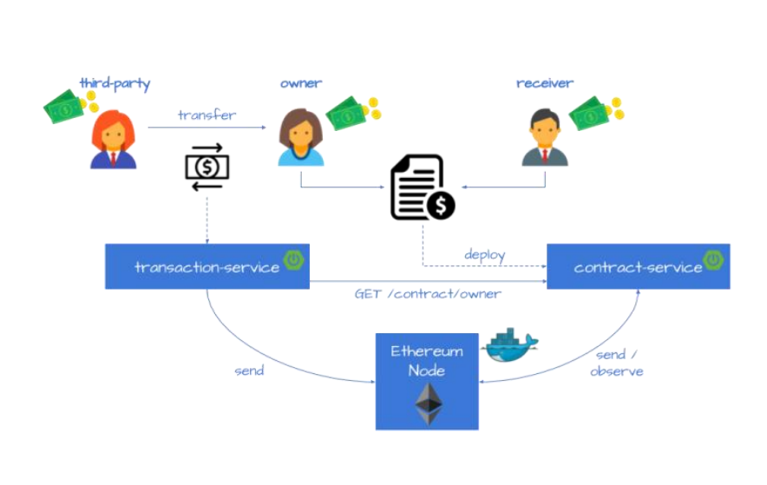
SYSTEM ARCHITECTURE

Slide 7
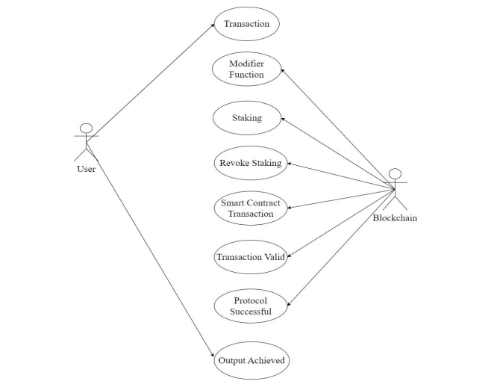
USECASE DIAGRAM

Slide 8
MODULE DESCRIPTION
Module Names
The Escrow Contract Implementation (to FacilitateTransaction)
Escrow Contract creating Smart-Contract Implementation
Front-End

Slide 9
The Escrow Contract Implementation (to FacilitateTransaction)
The Eskro.sol contract is used to facilitate the transaction betweentwotrustless parties.
● SafeMath.sol
SafeMath.sol from OpenZeppelin is imported here.(It validatesif
an arithmetic operation will result in integer overflow/underflow).
● Modifiers- onlyParties() ,onlyBuyer(),onlyActive() modifiers are definedtomake sure that the associated function can be called by onlycertainpeople or can be called under only certain circumstances.
● stake() - This Function is used for the parties to stake some amount of ETHthat they can’t withdraw until both parties reach a consensus andagree to either cancel or proceed with their trade.
● revokeStake()- This allows parties to withdraw their staked fund if the contract hasnot been locked yet.
● cancel()- This function is used to cancel transactions. This can be revokedbythe revokeCancellation() function.

Slide 10
Escrow Contract creating Smart-Contract Implementation
The Escrow contract to facilitate the transaction between two trustlessparties are created is created by a contract called EsKroFactory.sol
● createContract() -
It takes buyer’s address,seller’s address,price as parameters.Createscontract and emits ContractCreated() event after successful
creation of Escrow contract.
● getContractsByIndex()-
It returns index of the contract that is created
● getContractsByAddress()-
It returns address of the contract
● getContracts()-
It returns all the contracts

Slide 11
Front-End
The ABI & address of the deployed contract is used along with thehelpof Ethers.js library to connect the frontend with the smart-contract.
Components- The code is divided into various components to keeptheproject clean and maintainable
● Wallet.js-
This is used as the connect button which helps users to connect their Metamask wallet with the web-app.
● Contract.js-
stake(),withdrawStake(),cancel(),revokeCancel(),confirm() functions are implemented in this component.The buttons for staking related all activities are handled by this component.
● ContractCreation.js-
Creation of the contract is handled in this component.

Slide 12
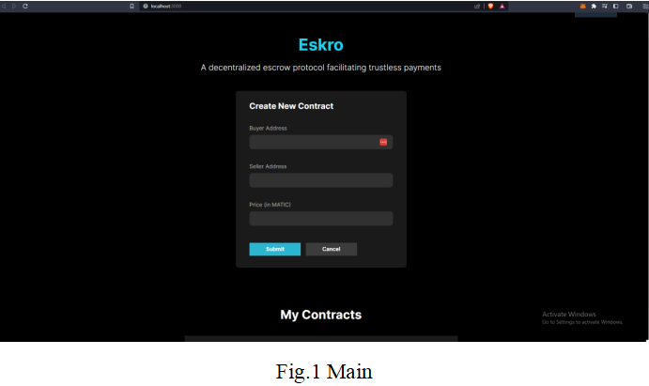
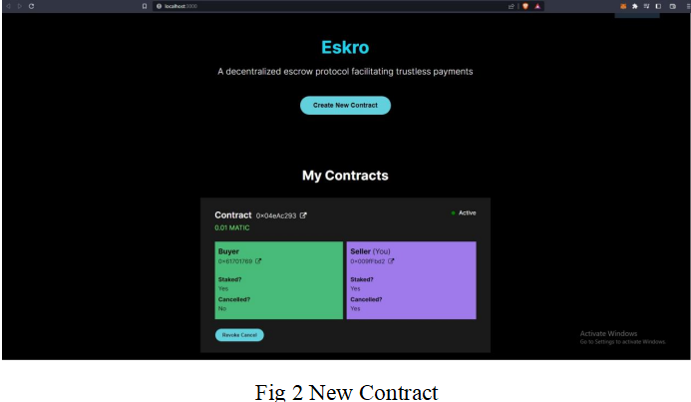
SCREENSHOTS :

Slide 13
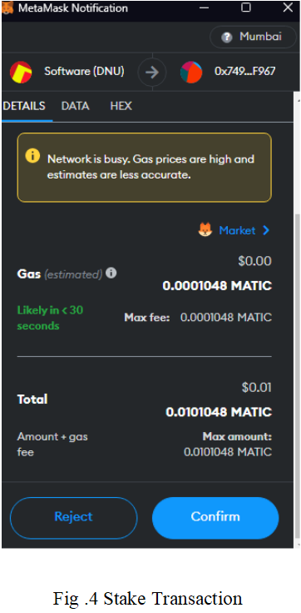
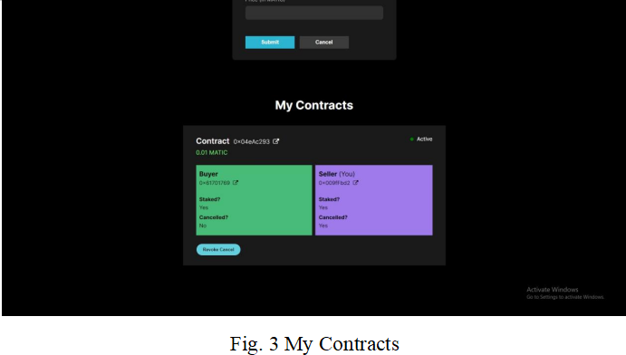

Slide 14
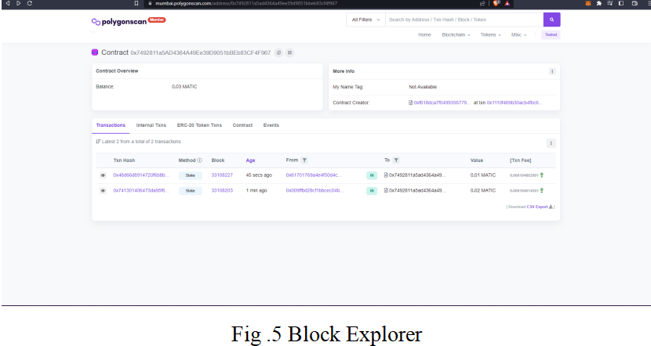
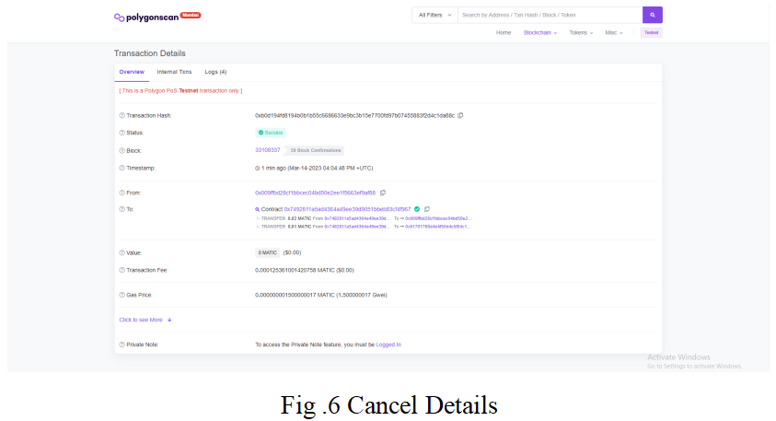

Slide 15
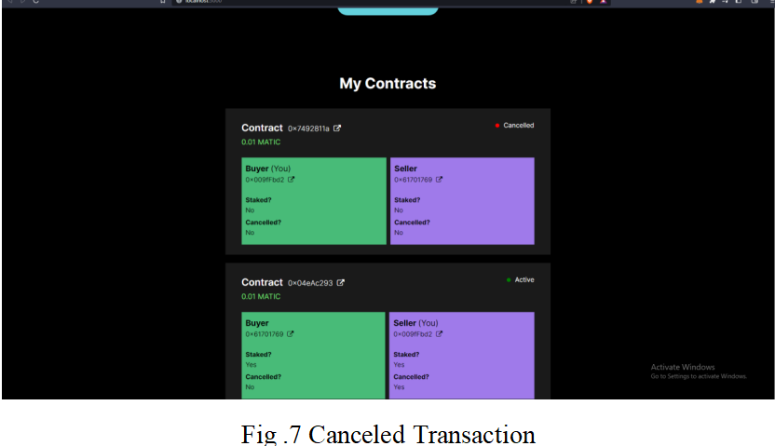
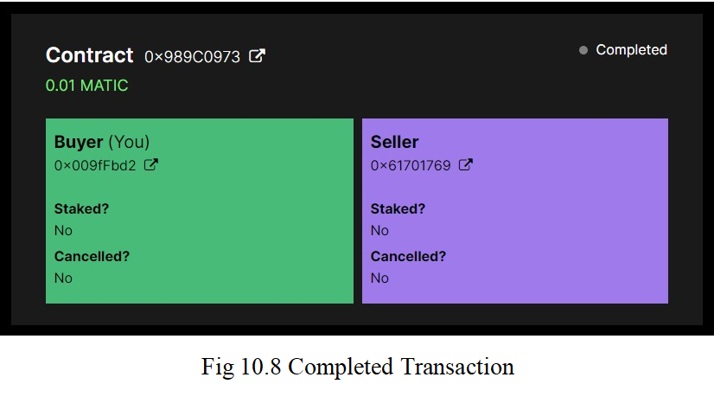

Slide 16
CONCLUSION
The escrow systems that we suggest are completely orthogonal tothemethod in which the files are shared and distributed among peers. Theescrow service and the verification of the content can be done bythepeer-to-peer service, or by a separate non-affiliated service. We hope that our study can stimulate more future research endeavors on this crucial problem in the blockchain.

Slide 17
THANK YOU

